Slide 1


Real-time lane instance segmentation
presented by Gad Mohamed. UG computer engineering student, Nile university

Slide 2
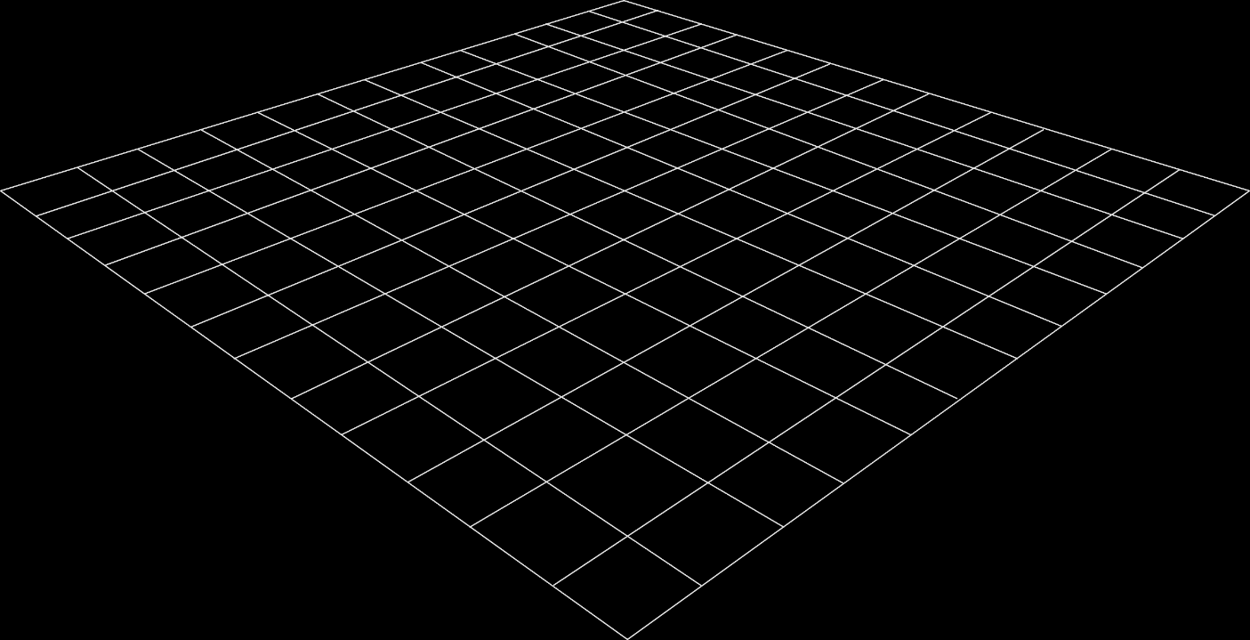
CONTENTS
Introduction
Literature review
Methodology
Results
Conclusion & future work

Slide 3
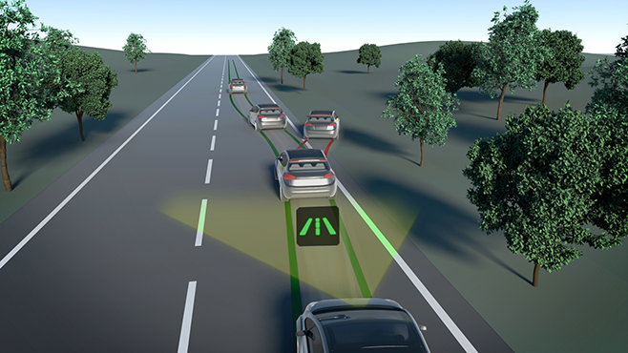
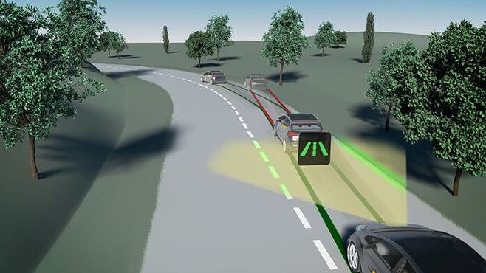
Problem statement
Lane detection is a perception task in modern/autonomous vehicles that is critical in many modern cars features nowadays.
Lane keeping assistant LKA
Road edge detection

Slide 4


Problem statement
In general, vehicle-based software solutions are complex because:
1- Limited resources on vehicle-based systems.
2- High standards imposed by safety regulations

Slide 5
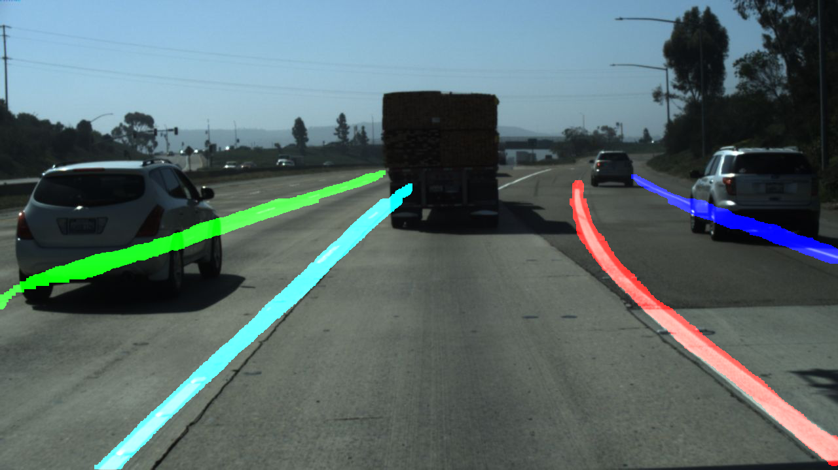
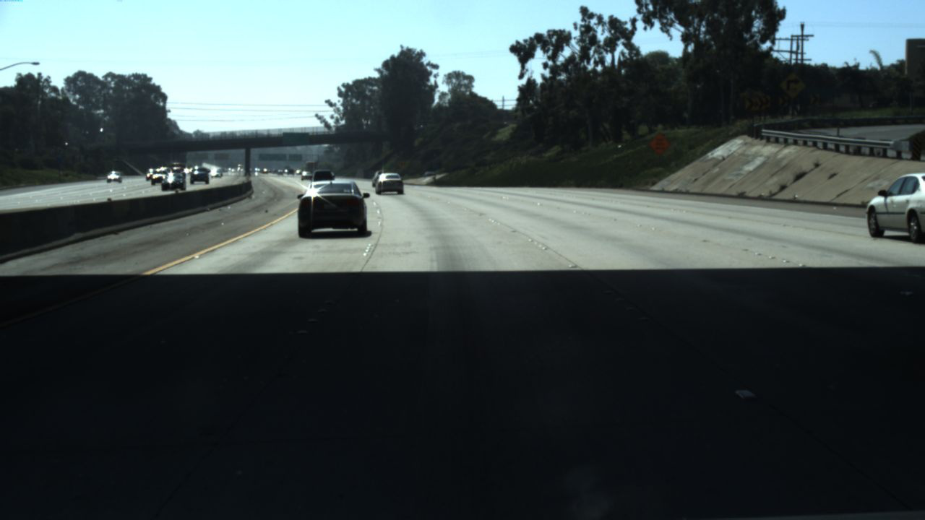
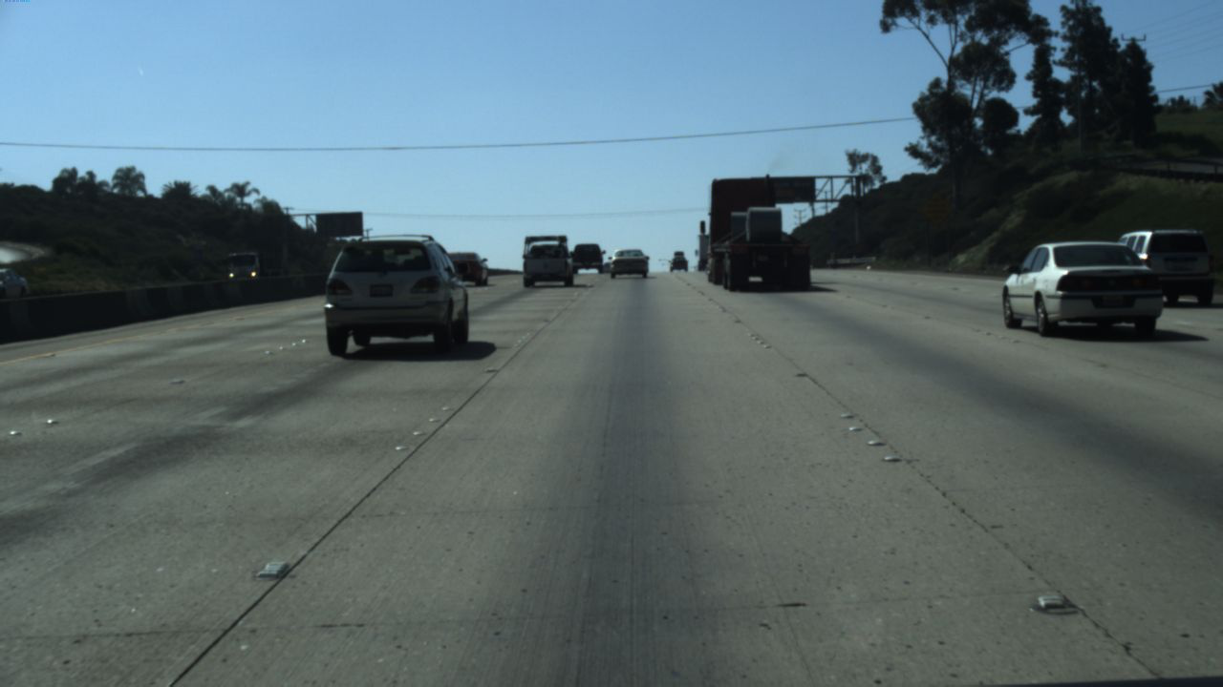
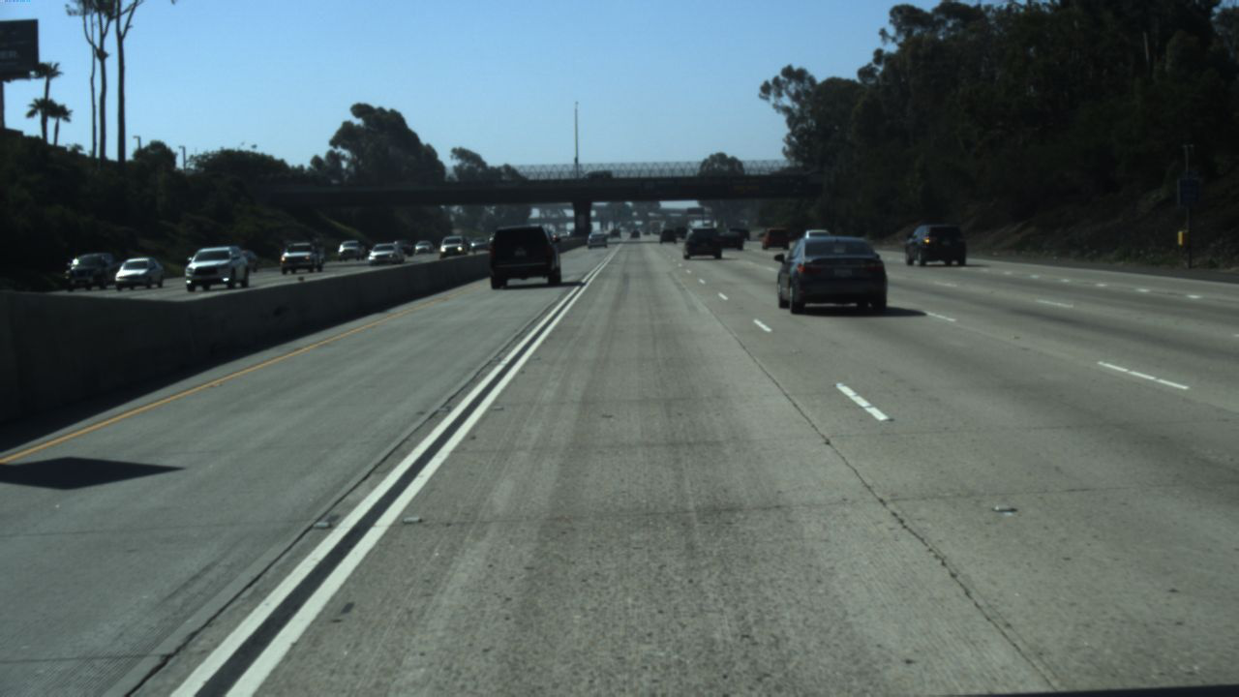
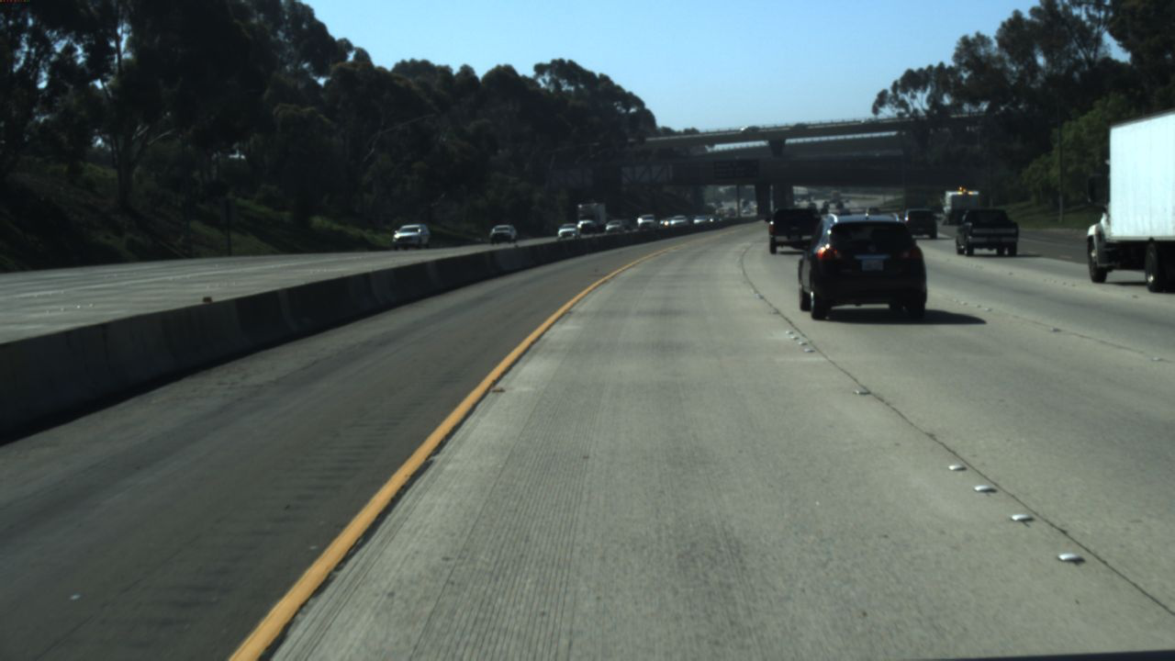
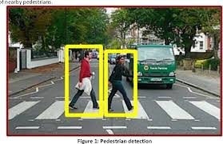
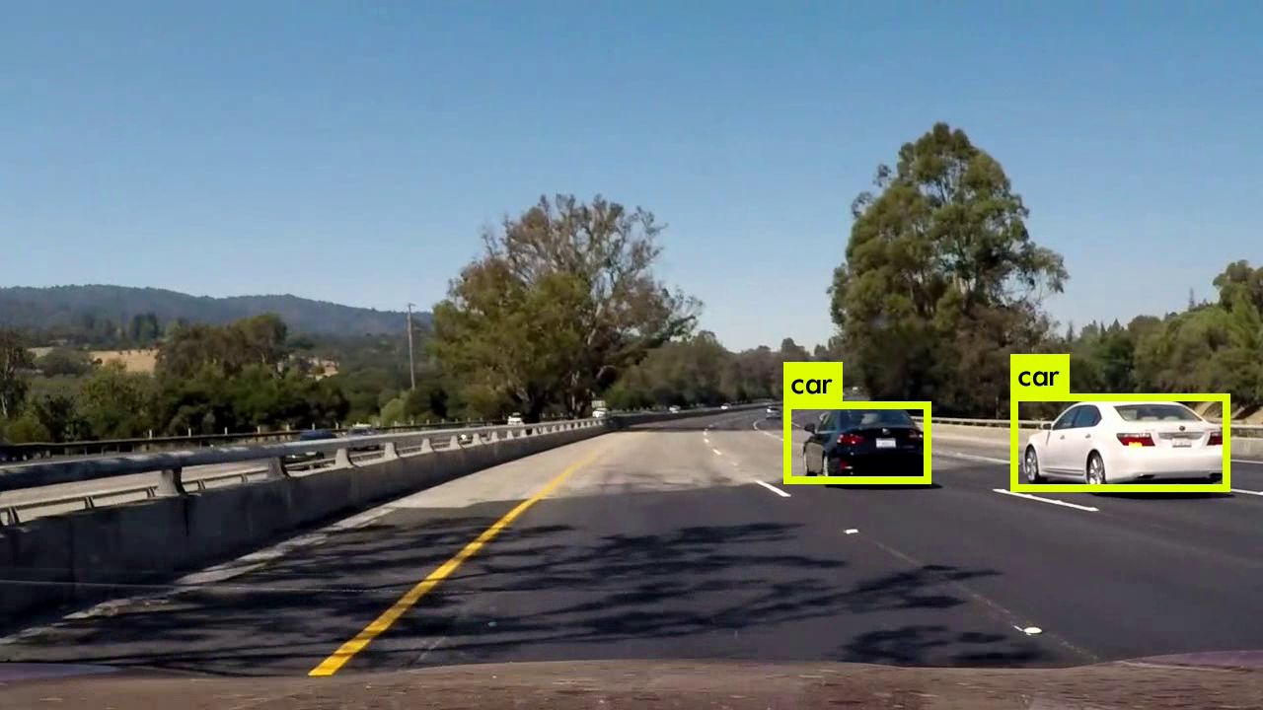
Problem statement
Particularly, lane detection is a challenging task because:
1- Variations and distortions in environment
2- Unique shape of lanes

Slide 6
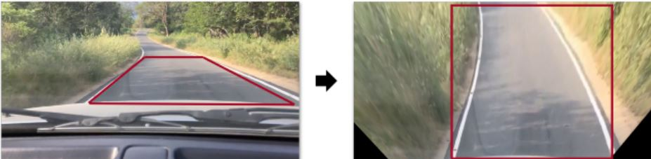
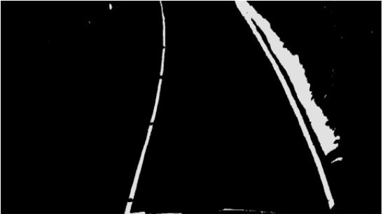
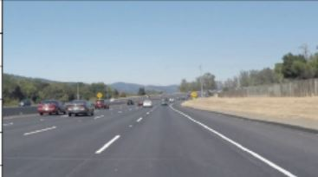
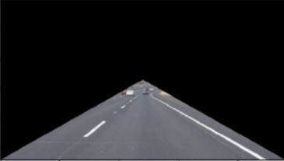
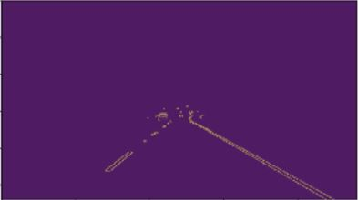
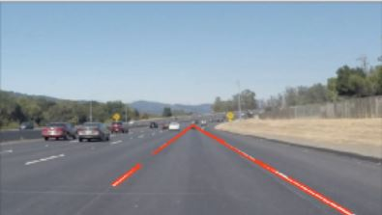
Literature review
Traditional method used feature engineering to rely on lane’s characteristics to detect them
1
2

Slide 7
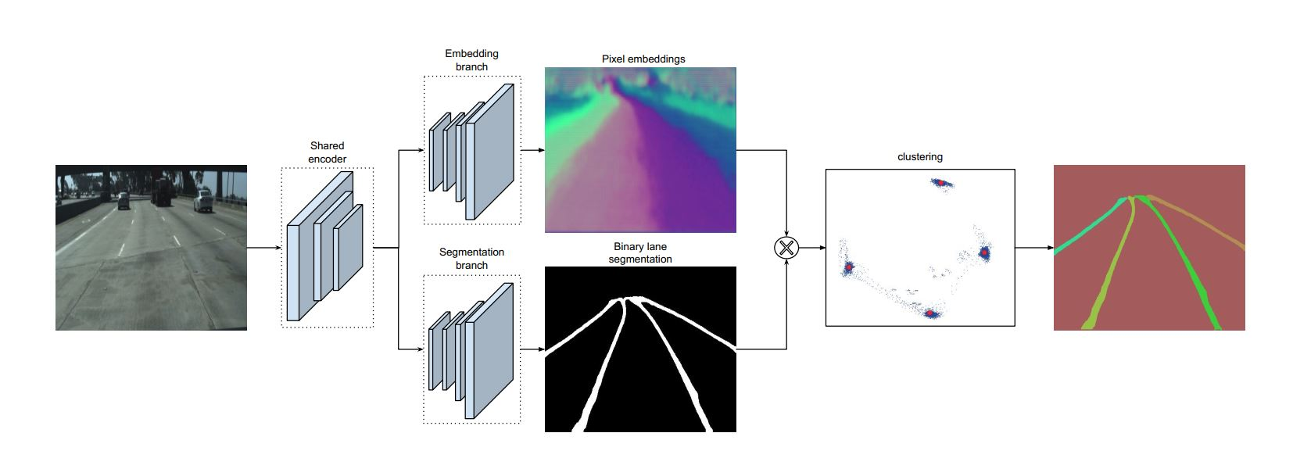
Literature review
More advanced approaches use deep-learning to improve feature extraction and robustness against environment distortions

Slide 8
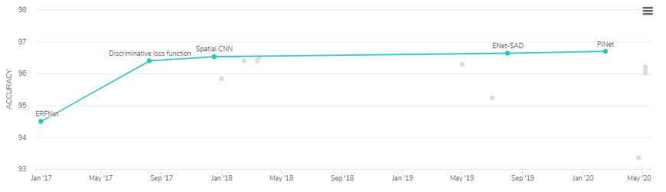
Literature review
State-of-the-art lane detection algorithms are deep-learning based !
Tested on tuSimple benchmark. Taken from: https://paperswithcode.com/sota/lane-detection-on-tusimple

Slide 9
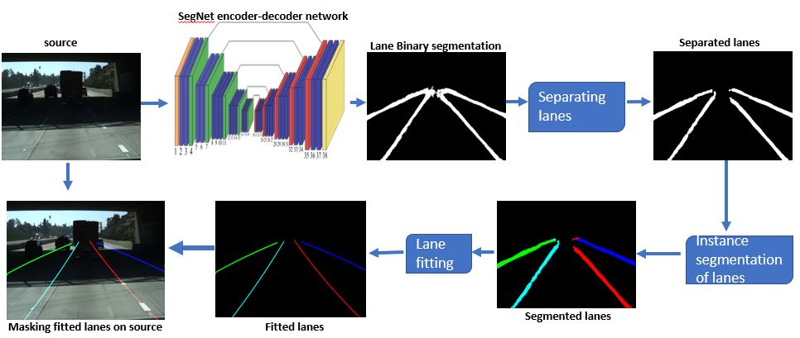
Methodology
Overview

Slide 10
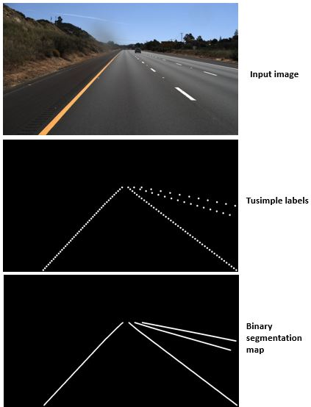
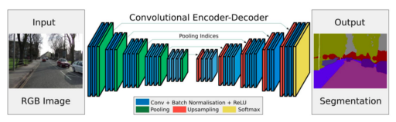
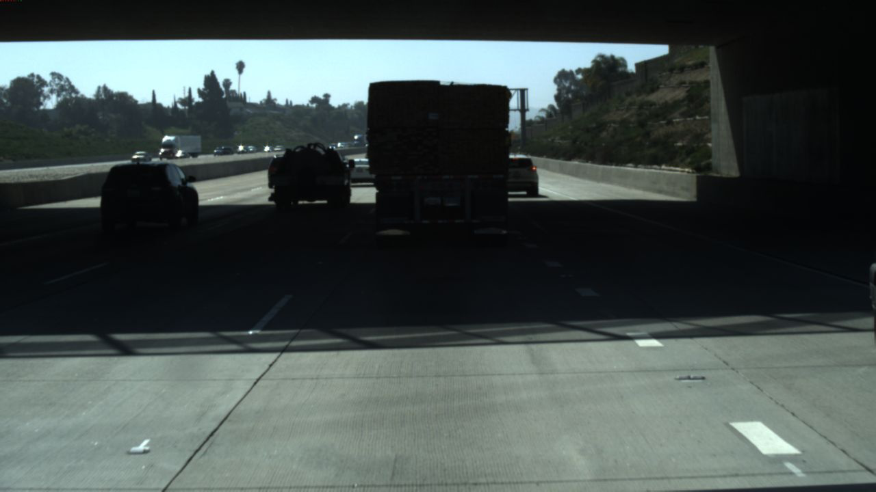
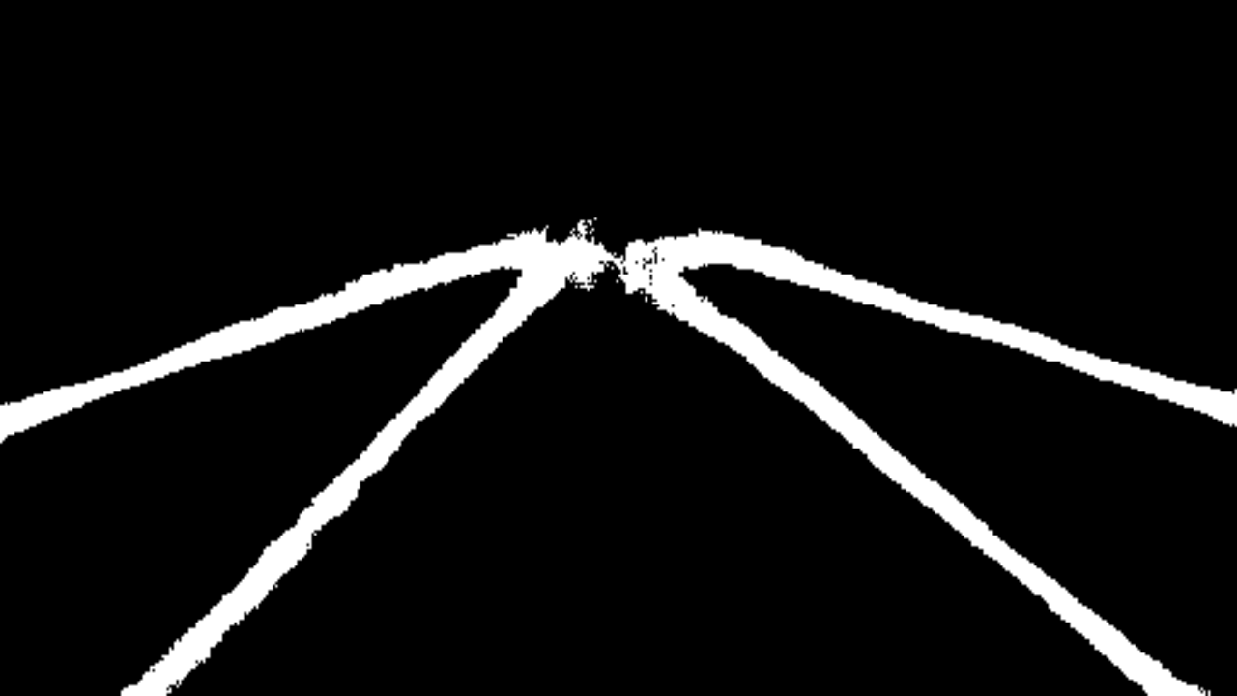
Methodology
Pre-processing data
Input image
tuSimple labels
SegNet labels
Architecture & training
Training dataset: 3626
Optimizer: Adam
Batch size: 8
Learning rate: 4e-4
Input size: 256,512,3
Output size: 256,512,2

Slide 11
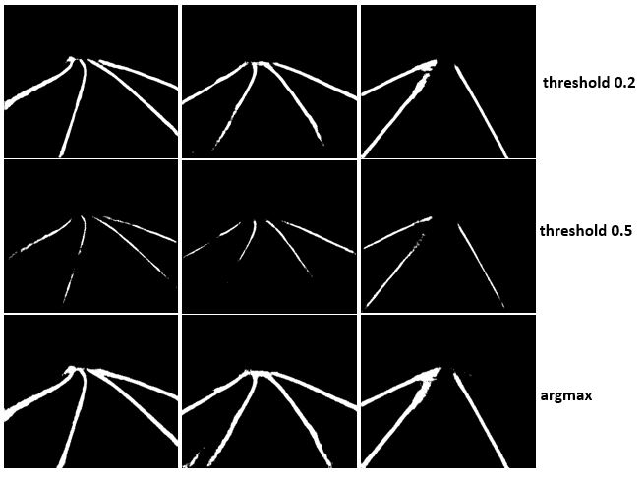
Methodology
Post-processing data
Should we use SoftMax to extract lane channel?
$$\operatorname{argmax}\left(B\left[i,j\right], axis=C)=\max_{c ε C}(B[i,j,c]\right)$$
Ex. 1
Ex. 2
Ex. 3

Slide 12
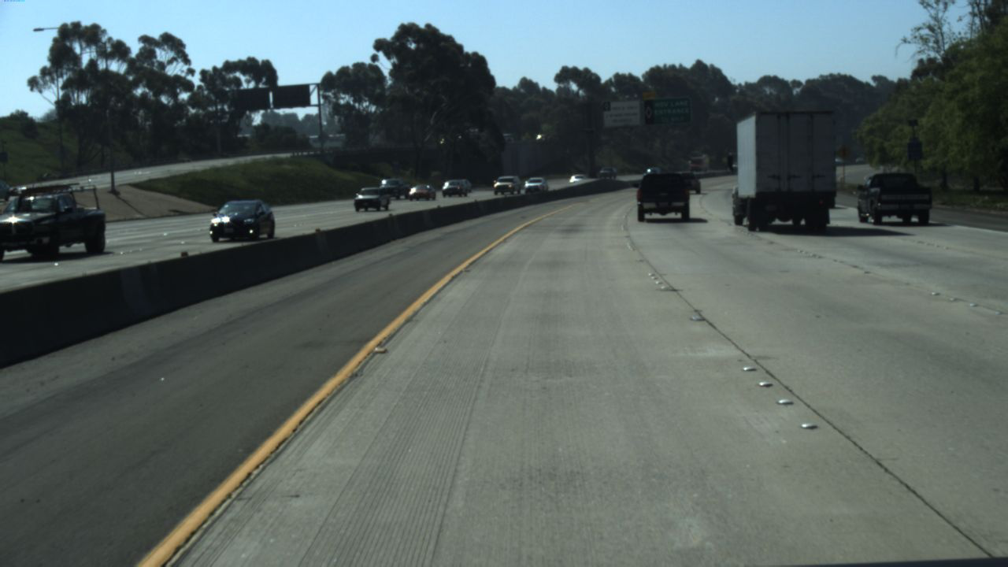
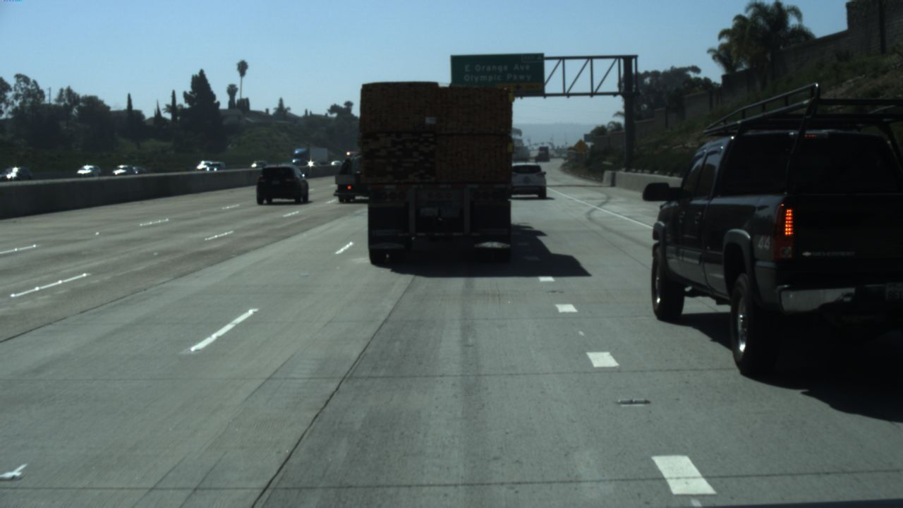
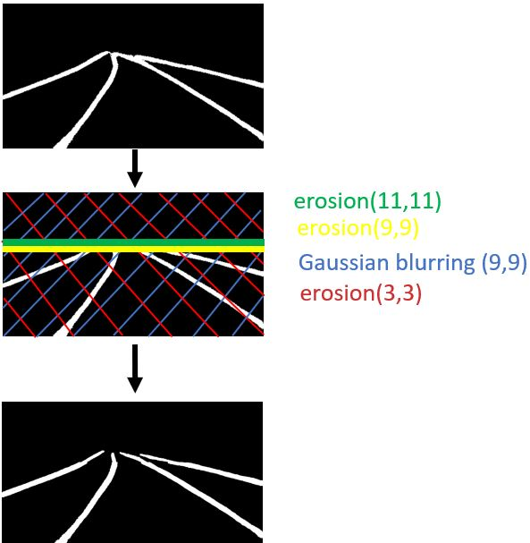
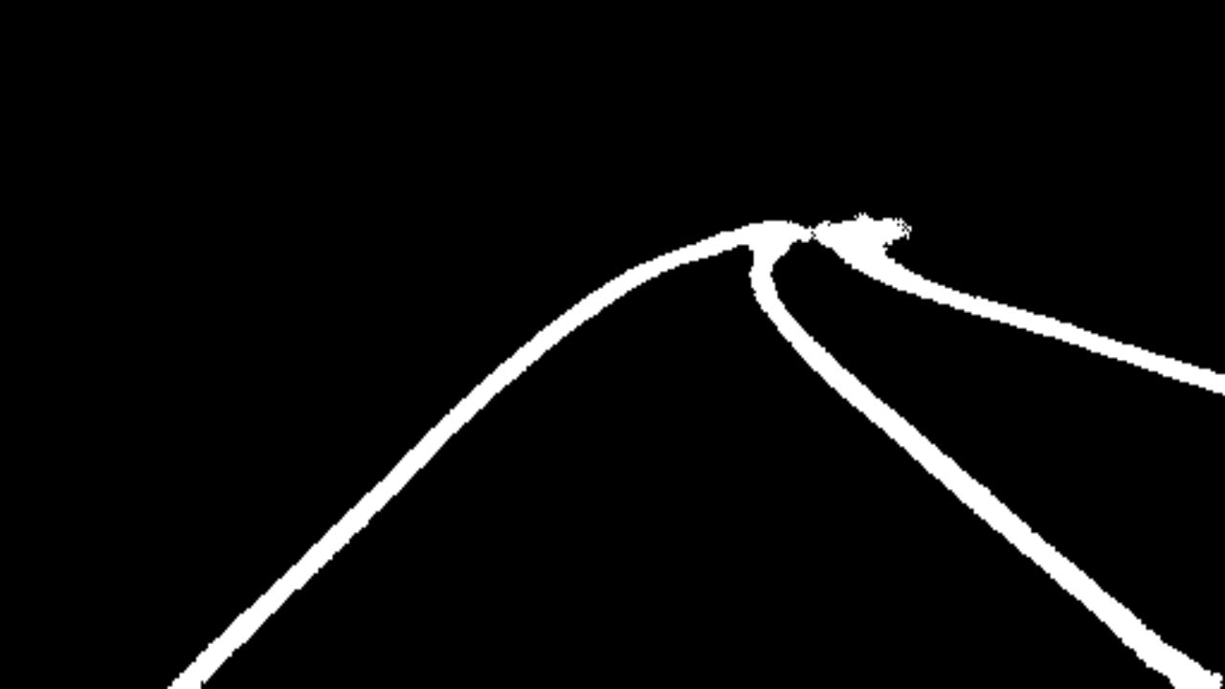
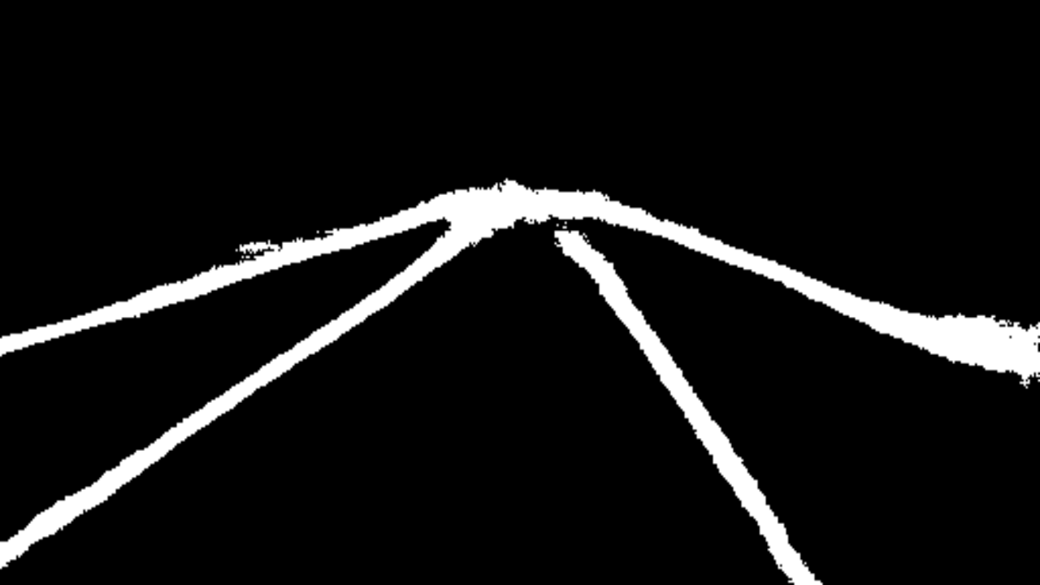
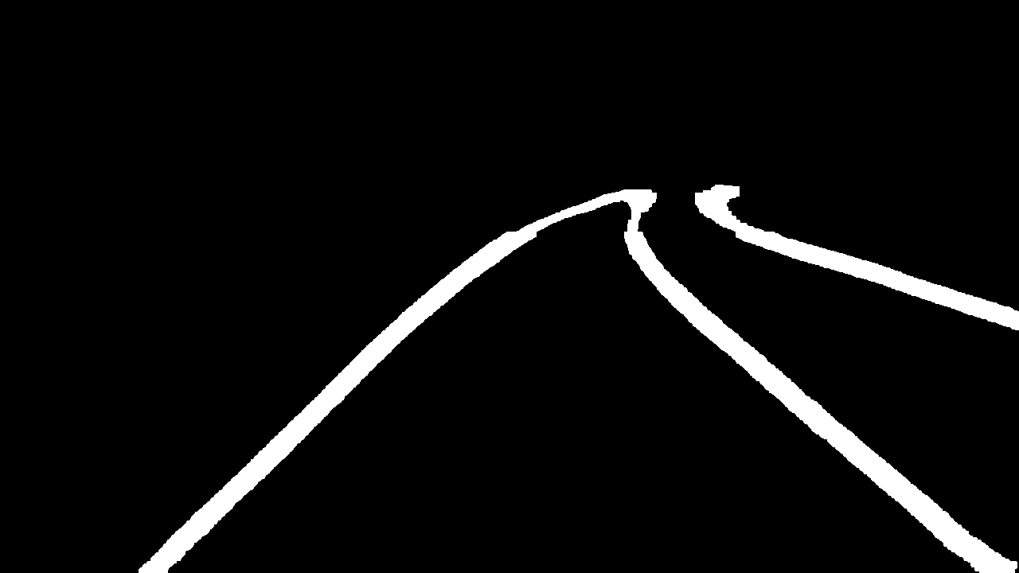
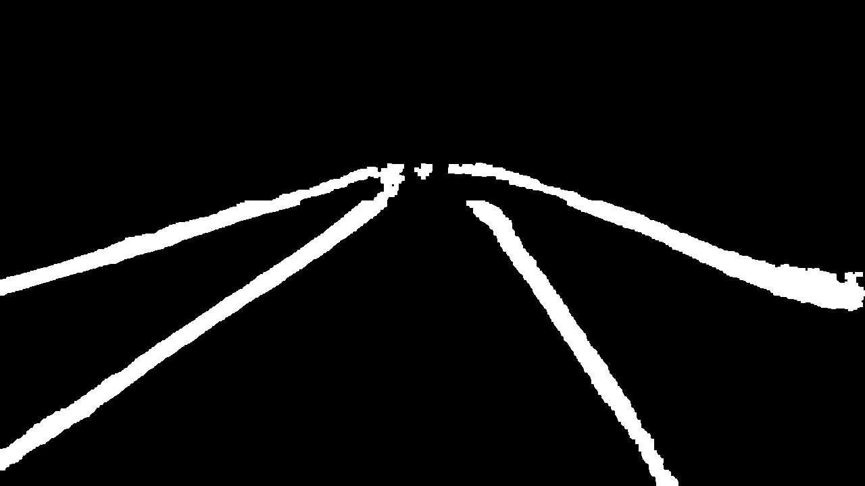
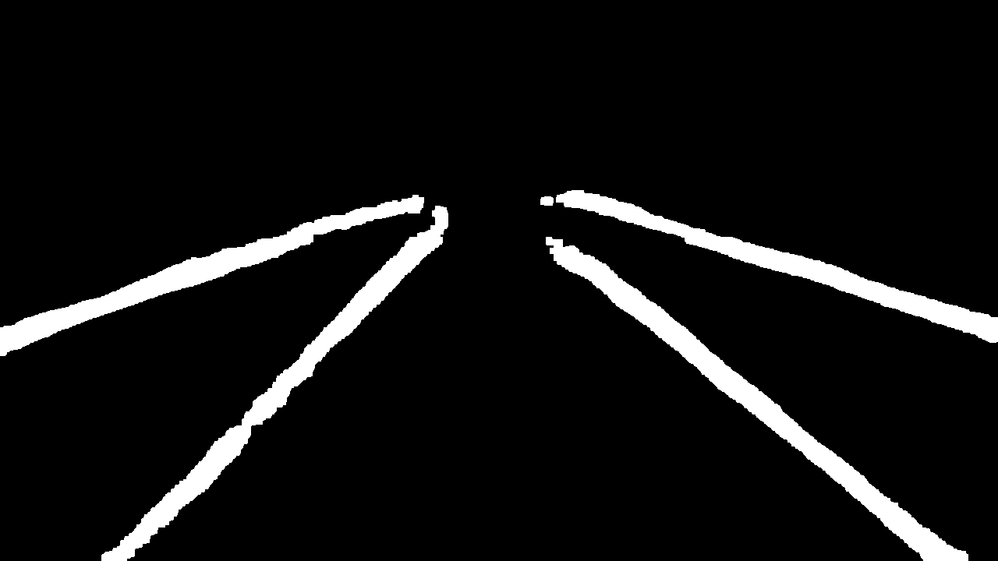
Methodology
Separating lanes
Image processing techniques like erosion and blurring are applied to separate the top point where all lanes meet in one point.

Slide 13
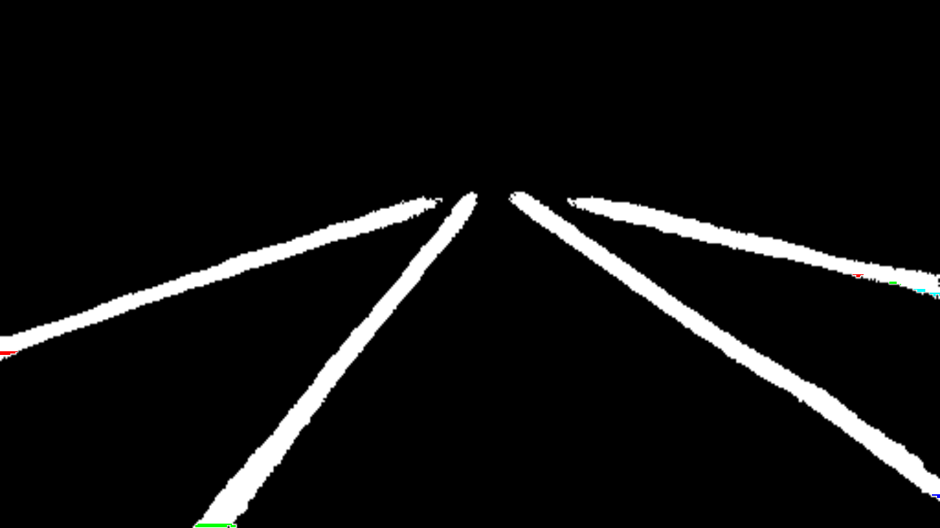
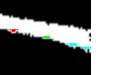

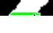
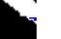
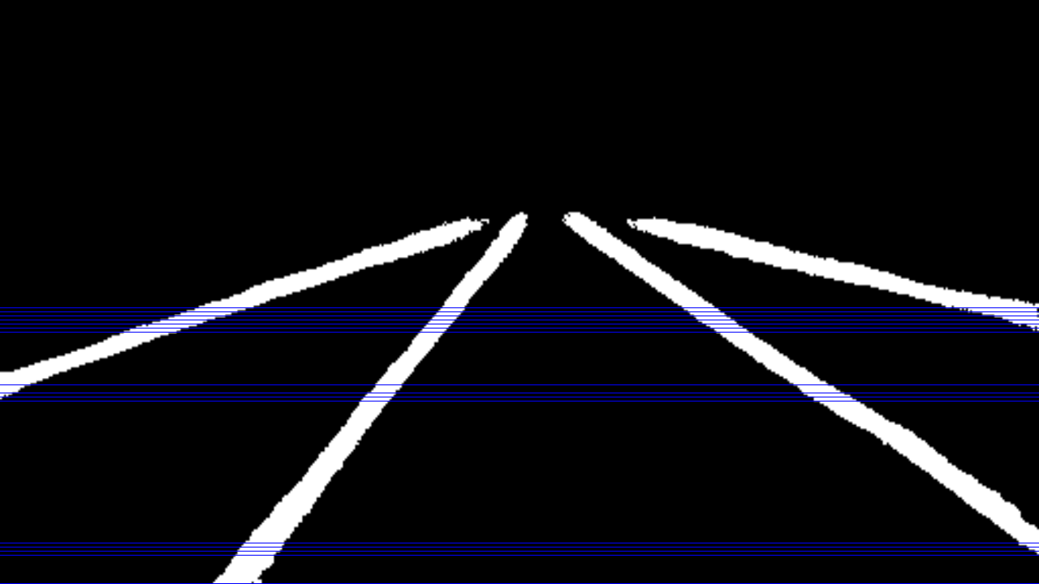
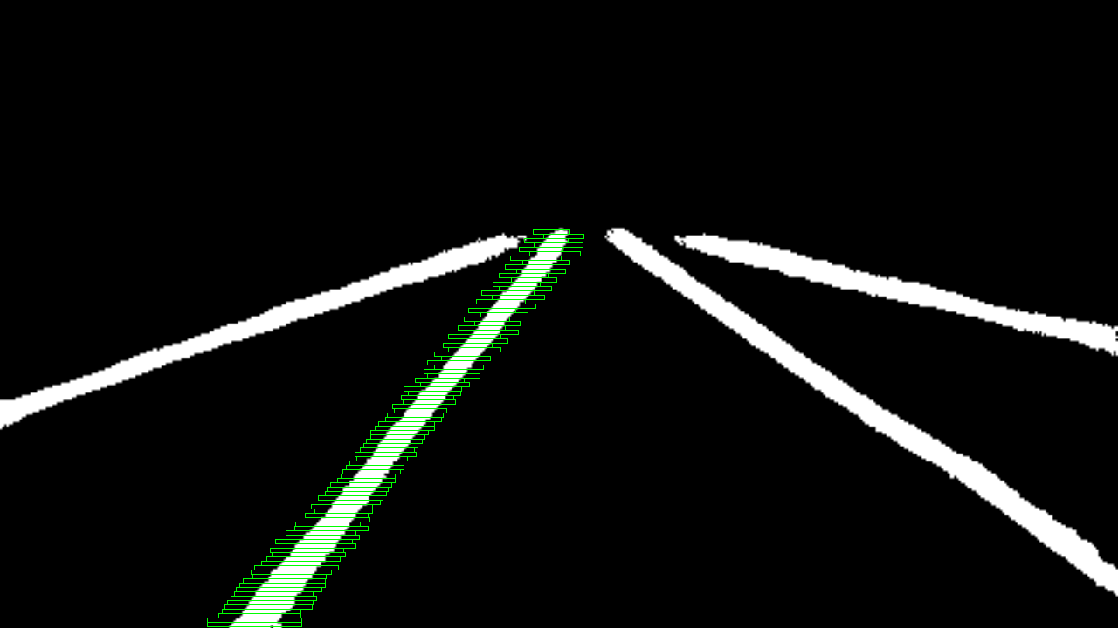
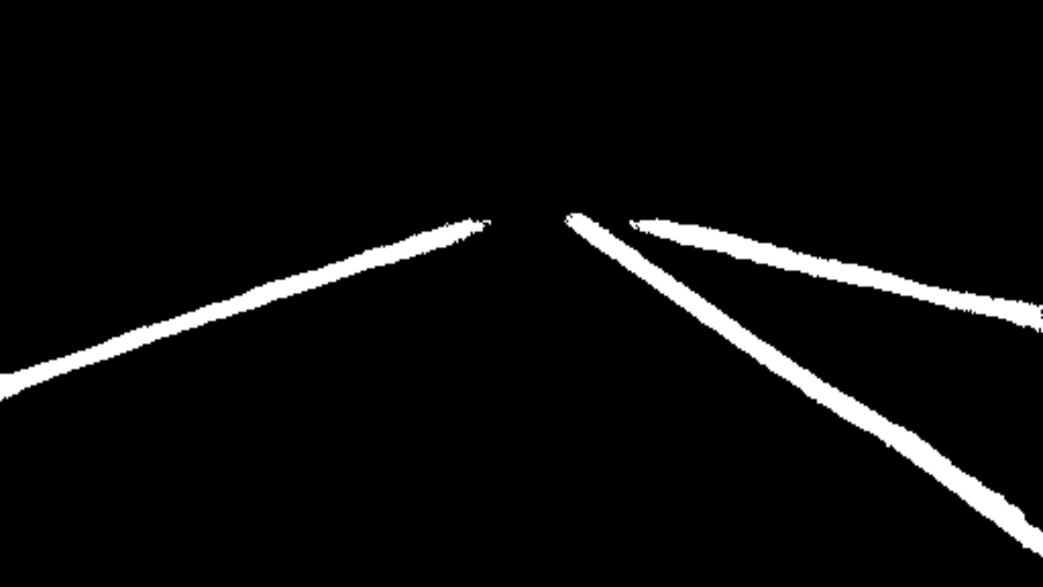

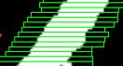
Methodology
Sliding window
Sliding window 1 scans from bottom to top.
When a cluster is found, sliding window 2 scans the targeted lane starting from its seed cluster and removes it from the image.

Slide 14
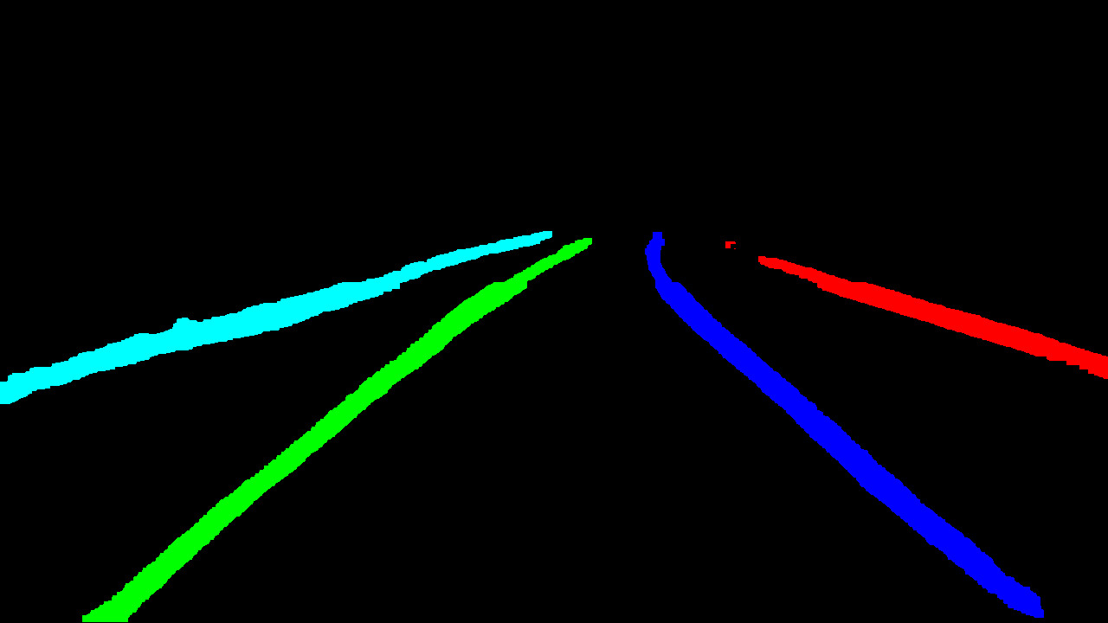
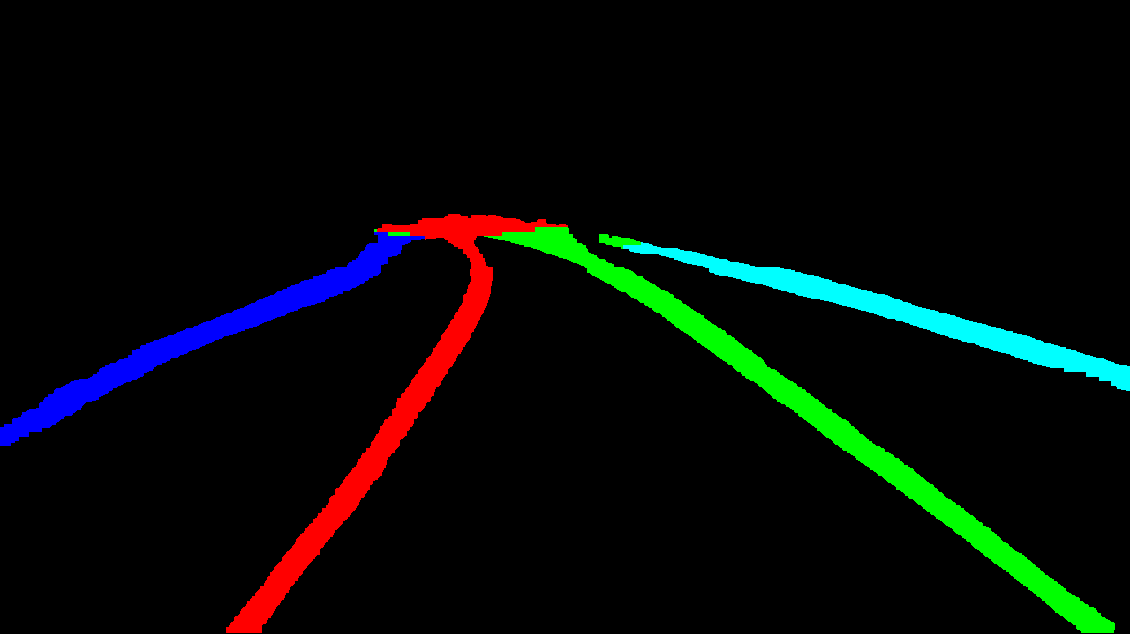
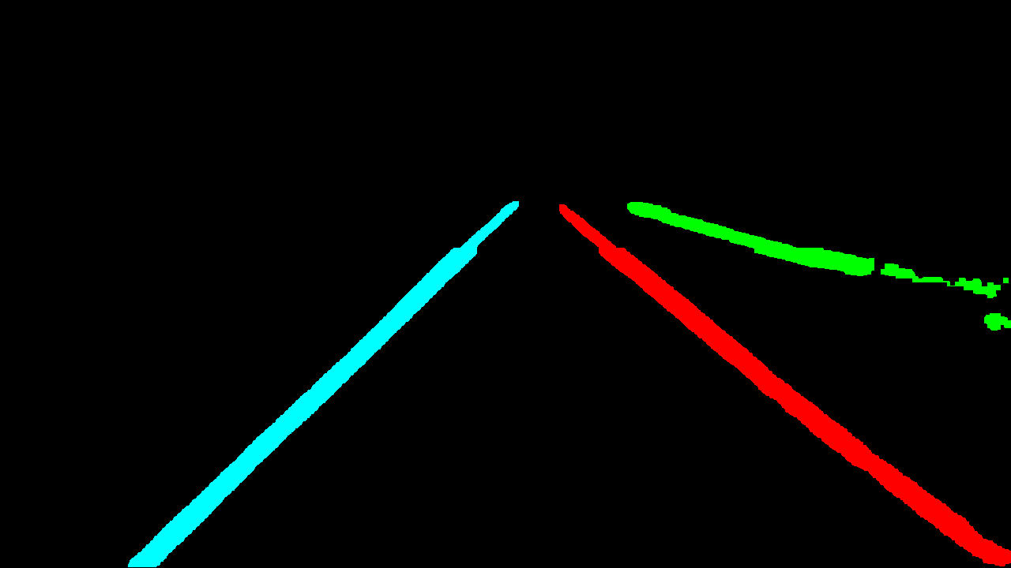
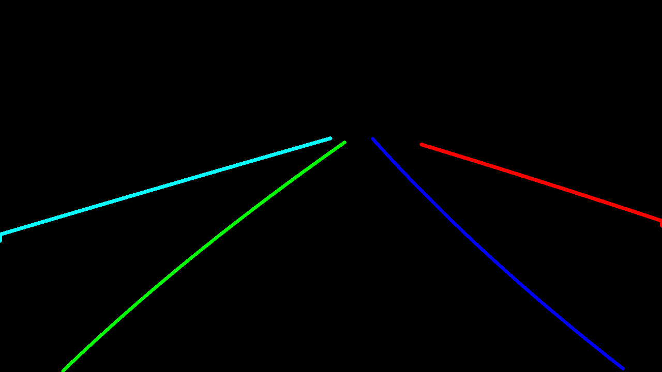
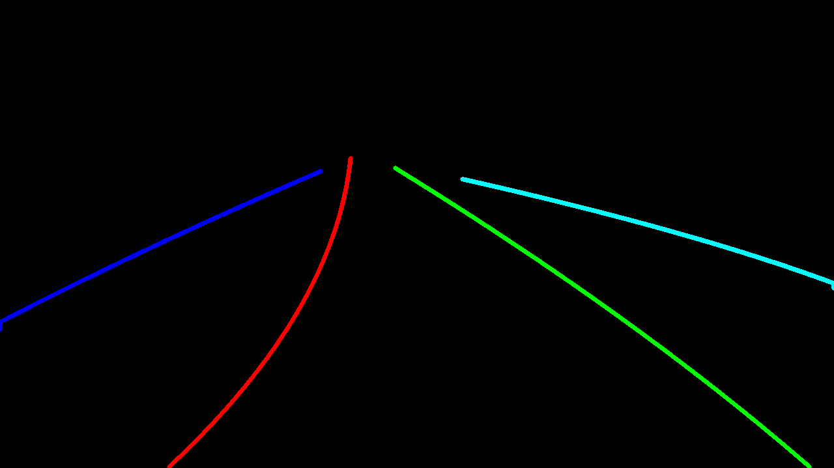
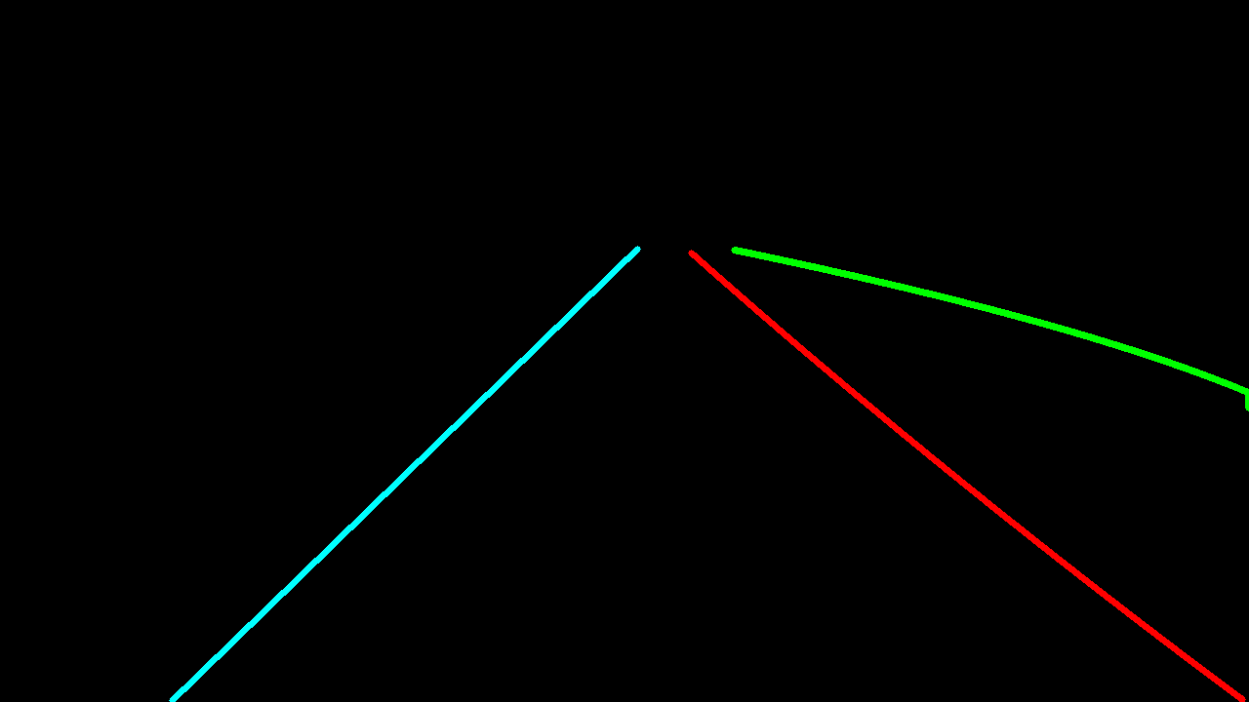
Methodology
Fitting lane
Each lane is fitted in a 3rd order function because:
control algorithms use perception results.
across frames, function parameters change can be expected/inferred.

Slide 15
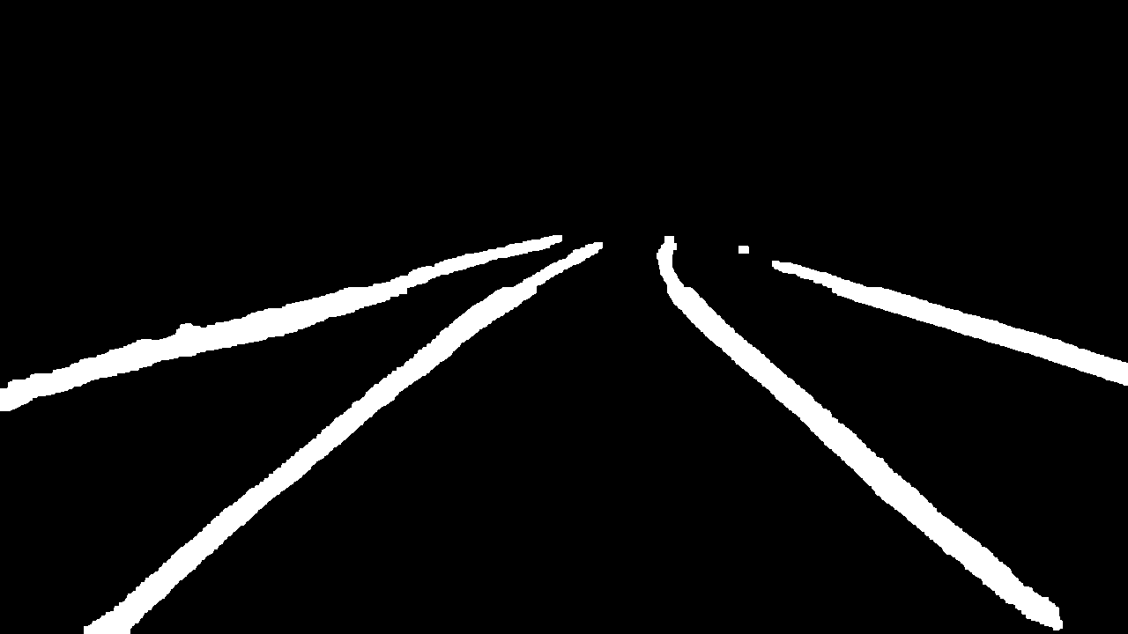
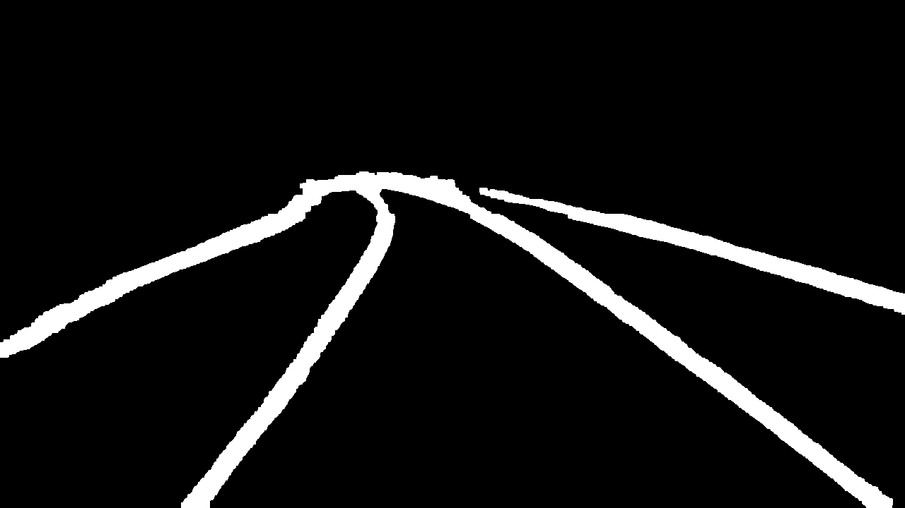
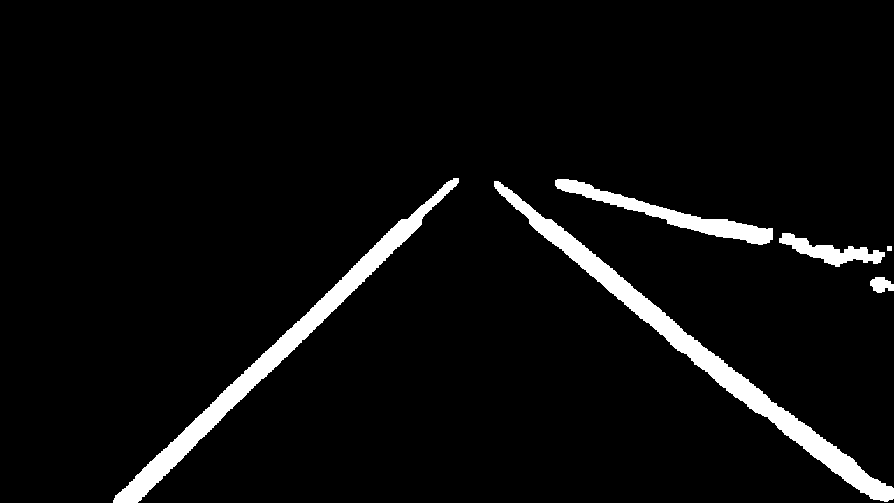
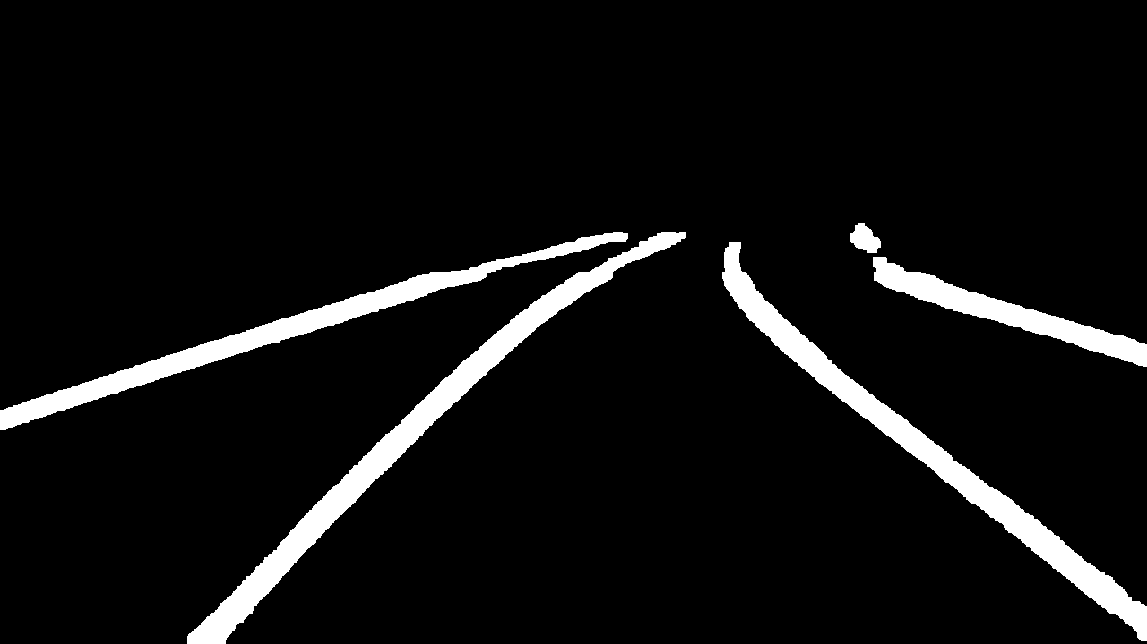









Results

Slide 16
Evaluation
 | LaneNet [11] | Our method
Forward pass time (ms) | 13.6 | 10
Postprocessing time (ms) | 1352 | 56
Total time (ms) | 1365.6 | 66
FPS | 0.7 | 15
Work | Acc | FP | FN
SCNN | 96.53% | 0.062 | 0.0180
LaneNet(+H-net) | 96.38% | 0.078 | 0.0244
PointLaneNet(MoblieNet) | 96.34% | 0.046 | 0.0518
ENet-SAD | 96.64% | 0.060 | 0.0205
KeyPointsEstimation(32x16) | 95.75% | 0.027 | 0.0362
KeyPointsEstimation(64x32) | 96.62% | 0.031 | 0.0272
Our method | 91.83% | 0.103 | 0.096
Comparing our method’s speed against LaneNet
Comparing our method’s accuracy against state-of-the-art algorithms
Model | Parameters (M)
SCNN | 20.72
LaneNet(+H-net) | 15.98
PointLaneNet(MoblieNet) | 5.33
ENet-SAD | 0.98
KeyPointsEstimation(32x16) | 4.4
KeyPointsEstimation(64x32) | 4.39
Our Model | 21.67
Comparing our model parameters against state-of-the-art algorithms

Slide 17
Conclusion & Future work
A real-time method for lane instance segmentation is proposed which runs at 15 fps on Tesla K80 GPU and achieve competitive accuracy on tuSimple benchmark.
An achievement of this work is to integrate the use of powerful deep-learning architectures and techniques with inexpensive postprocessing address both accuracy and speed challenges.
As a future work, SegNet performance will be improved by providing more data to train on and new methods will be explored to address weak points in this method namely, improving lanes separation, to increase accuracy.

Slide 18
THANK YOU

